Slide 1

DHCP & DNS
Explore Network Configurations Protocols

Slide 2
AGENDA
INTRODUCTION
WHAT IS DHCP?
HOW DHCP WORKS
WHAT IS DNS?
HOW DNS WORKS
DHCP VS DNS
REAL-WORLD APPLICATIONS
CONCLUSION

Slide 3

INTRODUCTION
In the world of networking, DHCP and DNS are two fundamental protocols.
They play crucial roles in the management and operation of networks.
DHCP manages the allocation of IP Addresses to end-user client devices such as Phones, tablets, laptops, etc.;
DNS used for translating the Domain name into the IP Address.

Slide 4

WHAT IS DHCP?
DHCP stands for Dynamic Host Configuration Protocol.
01
It is a network management protocol used to automate the process of configuring devices on IP networks.
02
DHCP allows devices to receive IP addresses and other network configuration parameters dynamically.
03

Slide 5
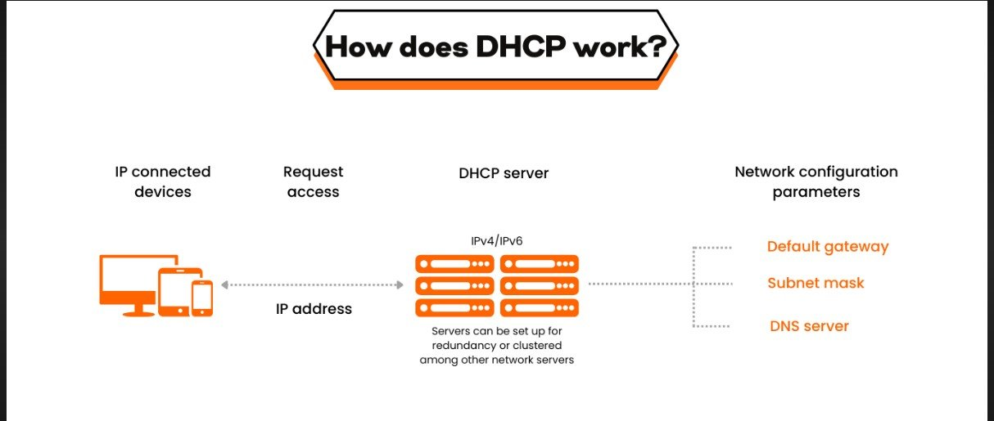

Slide 6
WHAT IS DNS?
DNS stands for Domain Name System.
It is a hierarchical and decentralized naming system for computers, services, or other resources.
DNS translates human-readable domain names (e.g., www.example.com) into IP addresses (e.g., 192.0.2.1).

Slide 8
Feature | DHCP | DNS
Full Form | Dynamic Host Configuration Protocol | Domain Name System
Purpose | Assigns IP addresses dynamically | Translates domain names to IP addresses
Function | Network management | Naming system
Key Benefit | Simplifies IP address management | Simplifies domain name resolution
Protocol Type | Network layer protocol | Application layer protocol
DHCP vs DNS

Slide 9

REAL- WORLD APPLICATIONS
DHCP:
Used in home and enterprise networks.
Essential for managing IPs in dynamic environments.
DNS:
Critical for accessing websites and online services.
Used in email systems to route messages.

Slide 10
CONCLUSION
DHCP and DNS are essential for modern networking.
DHCP automates IP address assignment.
DNS translates domain names to IP addresses.
Understanding both is crucial for IT professionals.

